Slide 1
Customer Churn Analysis
Data Presentation
BY: Nikhil Kushwaha

Slide 2
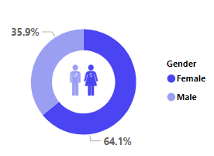
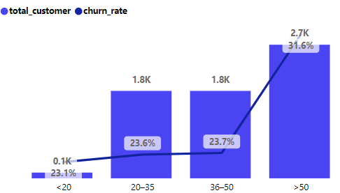
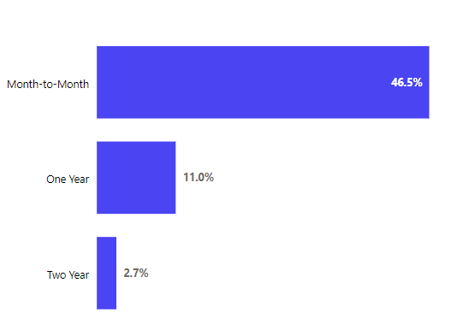
Summary
High churn in specific demographics (Churn Rate by Gender and Age Group)
Business Context: Female customers contribute 64.1% of the total churn, with the highest churn in the age group above 50 (31.6%).
Recommendation: Develop targeted retention strategies for older customers and improve offerings tailored for women.
Contract type impacts churn significantly (Churn Rate by Contract)
Business Context: Month-to-month contracts show a 46.5% churn rate, much higher than long-term contracts like two years (2.7%).
Recommendation: Incentivize customers to switch to annual or bi-annual contracts to reduce churn.

Slide 3
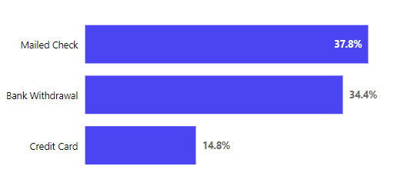
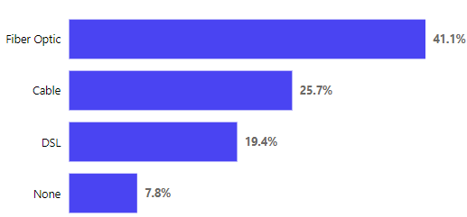
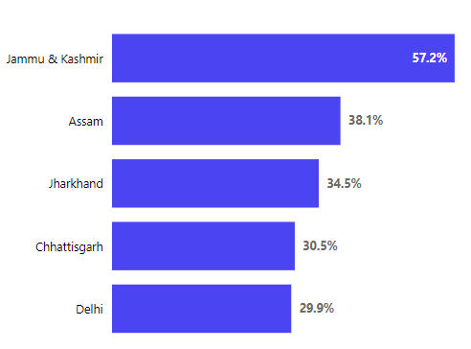
Churn is driven by payment methods (Churn Rate by Payment Method)
Business Context: Customers using mailed checks have the highest churn rate at 37.8%.
Recommendation: Promote digital payment methods like credit cards or bank withdrawals through discounts or rewards.
Internet service type correlates with churn (Churn Rate by Internet Type)
Business Context: Fiber Optic users face the highest churn (41.1%), indicating potential dissatisfaction with service quality.
Recommendation: Focus on improving Fiber Optic services or providing competitive offers to retain these customers.
Geographic churn trends (Churn Rate by States)
Business Context: States like Jammu & Kashmir (57.2%) and Assam (38.1%) show exceptionally high churn rates.
Recommendation: Investigate regional challenges, such as service disruptions or lack of localized support.

Slide 4
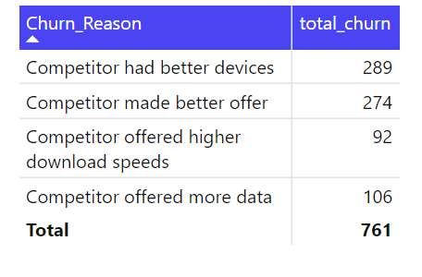
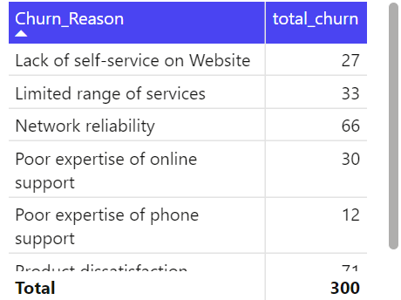
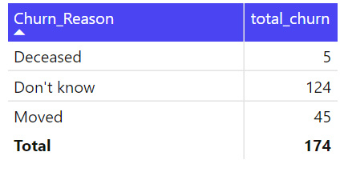
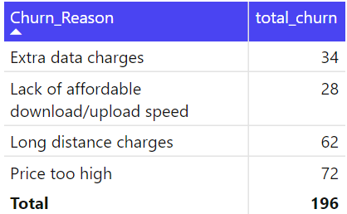
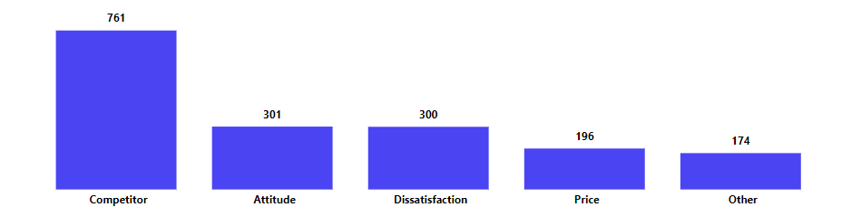
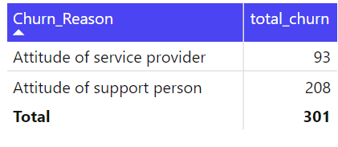
Insights:
Competitor Influence: The majority of churns are due to competitors offering better devices and deals.
Service Attitude: A significant number of customers left due to poor service attitude.
Dissatisfaction: Network reliability and product dissatisfaction are major pain points.
Price Sensitivity: High prices and extra charges are driving customer away
Other Factors: A notable portion of churns is due to unknown reasons
Action Plan:
Competitive Analysis: Conduct a thorough analysis of competitors' offerings and adjust our services accordingly.
Service Improvement: Train support staff to improve customer interactions and address attitude issues.
Product Enhancement: Focus on improving network reliability and expanding the range of services.
Pricing Strategy: Reevaluate pricing structures to offer more competitive rates and reduce extra charges.
Customer Feedback: Implement a system to gather and analyze customer feedback to address unknown churn reasons.

Slide 5
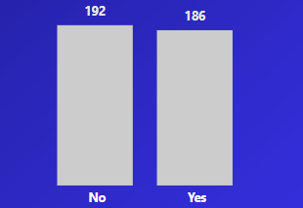

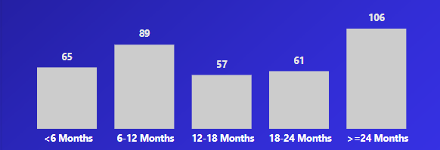
Churn Analysis - Prediction
Demographic profile of churners (Predicted Churner Profile)
Business Context: Female customers 245 and married individuals 186 dominate the predicted churner pool.
Recommendation: Tailor retention strategies for these groups, such as loyalty programs for long-term customers.
Tenure correlates with churn risk (By Monthly Tenure)
Business Context: Customers with tenure below six months 65 churners are at a higher risk, but churn risk persists even for customers with tenure >24 months 106 churners.
Recommendation: Implement proactive engagement strategies for new customers and loyalty incentives for long-term customers.

Slide 6
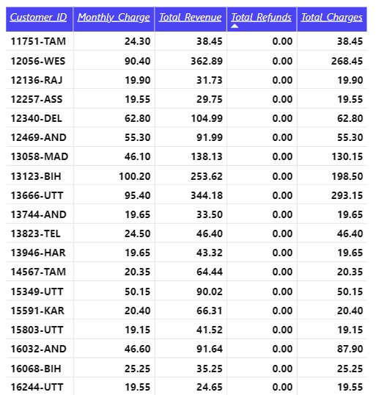
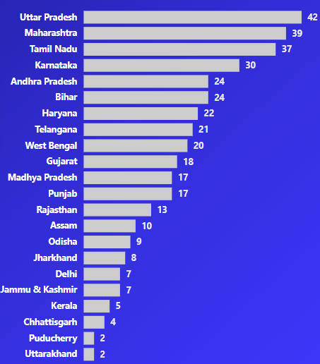
Monthly revenue opportunities (Predicted Churners Table)
Business Context: Customers with high monthly charges (e.g., ₹100+) are churning. Retaining them could significantly boost revenue.
Recommendation: Provide personalized offers to high-value customers to prevent churn.
State-specific predictions (Predicted Churner by States)
Business Context: States like Uttar Pradesh 42 churners and Maharashtra 39 churners have the highest predicted churners.
Recommendation: Focus retention campaigns and service improvements in these states.

